Slide 1
Distributed Algorithms

Slide 2
Mutual Exclusion
Certain shared data structures have to be protected to prevent interference during concurrent operations. i.e. critical regions
Single processor systems use semaphores and monitors to achieve mutual exclusion.
Algorithms for distributed mutual exclusion include:
  centralised algorithm
  distributed algorithm
  token ring algorithm
V1.2
Distributed Algorithms

Slide 3
Centralised Algorithm
One process is elected as a coordinator.
A process wishing to enter a critical region (CR) asks the coordinator for permission.
If no other process is using the critical region, the coordinator tells the requesting process to proceed.
If the critical region is in use, the coordinator queues the request (it may inform the requesting process of this). When the critical region becomes free the coordinator tells the first process on the queue to proceed.
V1.2
Distributed Algorithms

Slide 4
Centralised Algorithm
Advantages:
  fair - requests granted in order.
  no process waits forever.
  easy to implement (request, grant, release messages only).
Disadvantages:
  Single point of failure.
  Coordinator may be bottleneck.
  Cannot distinguish between dead coordinator and CR busy.
V1.2
Distributed Algorithms

Slide 5
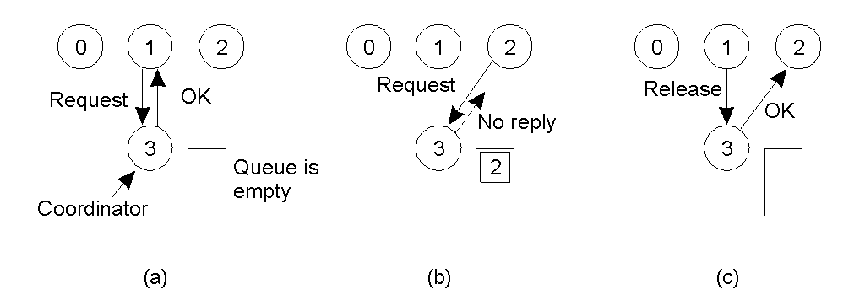
Mutual Exclusion: Centralized Algorithm
Process 1 asks the coordinator for permission to enter a critical region. Permission is granted
Process 2 then asks permission to enter the same critical region. The coordinator does not reply.
When process 1 exits the critical region, it tells the coordinator, which then replies to 2
V1.2
Distributed Algorithms

Slide 6
Distributed Algorithm
Proposed by Lamport; Ricart & Agrawala
Requires total ordering of events.
Requesting process builds a message containing critical region (CR) name, its process number and current time. It sends this message (reliably) to all other processes.
V1.2
Distributed Algorithms

Slide 7
Distributed Algorithm
When a process receives a request message then:
  if it is not in the CR and does not want to enter it,the receiver tells the requestor OK.
  if it is already in the CR, it does not reply and queues the request.
  if it wants to enter the CR, it compares the requests timestamp to the one it sent on its request. If the incoming timestamp is lower it tells the requestor OK, otherwise it queues the incoming request.
V1.2
Distributed Algorithms

Slide 8
Distributed Algorithm
The requesting process waits for all the responses to come back giving it permission to enter the CR.
When it exits the CR it sends OK messages to all its queued requests and deletes the queue.
V1.2
Distributed Algorithms

Slide 9
Distributed Algorithm
Advantages:
  no single point of failure
  demonstrates distributed algorithm is possible
Disadvantages:
  2(n-1) messages where n = number of processes
  multiple points of failure
  Group communication needed or membership lists
  All processes involved in all decisions
V1.2
Distributed Algorithms

Slide 10
Distributed Algorithm
Modifications that can be made include:
  Timeouts on requests
  Explicit 'CR in use' messages
  Use simple majority to enter critical region
V1.2
Distributed Algorithms

Slide 11
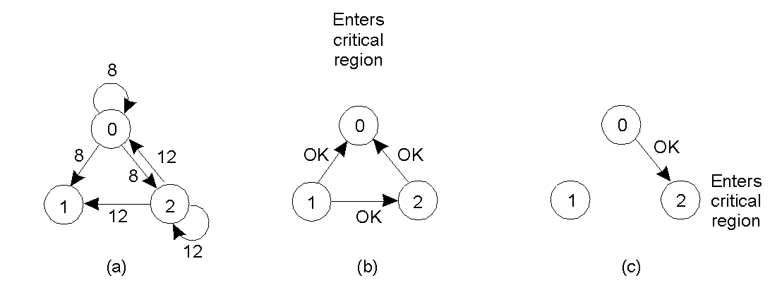
A Distributed Algorithm
Two processes want to enter the same critical region at the same moment.
Process 0 has the lowest timestamp, so it wins.
When process 0 is done, it sends an OK also, so 2 can now enter the critical region.
V1.2
Distributed Algorithms
Notes:
Process 0 gets priority (lowest process id). N points of failure. On receipt of a request a response is sent.

Slide 12
Token Ring Algorithm
A logical ring is constructed in which each process is assigned a position in the ring.
The ring is initialised (ie brought to a known state) and a token given to the first process (process 0).
The token circulates around the ring.
When a process acquires the token it enters a critical region if it needs to. When it returns from the critical region it released the token to the next process.
V1.2
Distributed Algorithms

Slide 13
Token Ring Algorithm
Advantages:
  Easy to prove correct
  No starvation (token circulates in a known order)
Disadvantages:
  Token may be lost (detection difficult as interval unbounded)
  Token holder may crash (ack on token receipt helps)
V1.2
Distributed Algorithms

Slide 14
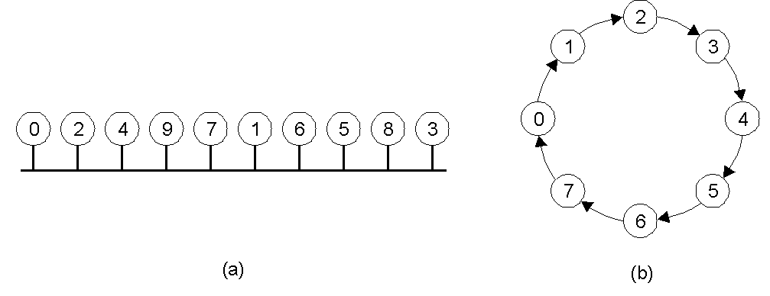
A Token Ring Algorithm
An unordered group of processes on a network.
A logical ring constructed in software.
V1.2
Distributed Algorithms

Slide 15
Election Algorithms
Many distributed algorithms need a coordinator.
All processes are identical
Selection normally based selecting the active process with the highest process identifier.
Each process must have a unique process id
Id’s of processes in system widely known
State of processes not known.
Election process concludes when every process knows who the new coordinator is.
V1.2
Distributed Algorithms

Slide 16
Bully Algorithm (Garcia-Molina)
A process P sends a election message to every process with a higher number.
If no one responds P wins the election and becomes coordinator.
If one of the higher-ups answers, it takes over.
When a process receives an election message from a lower numbered process it responds indicating it is ready to take over the election and sends out an election message (providing it is not already holding an election).
V1.2
Distributed Algorithms

Slide 17
Bully Algorithm (Garcia-Molina)
Eventually all processes give up except one who sends out a victory message to declare its new status as co-ordinator (and biggest bully).
If a process that was down comes back up then it holds an election.
V1.2
Distributed Algorithms

Slide 18
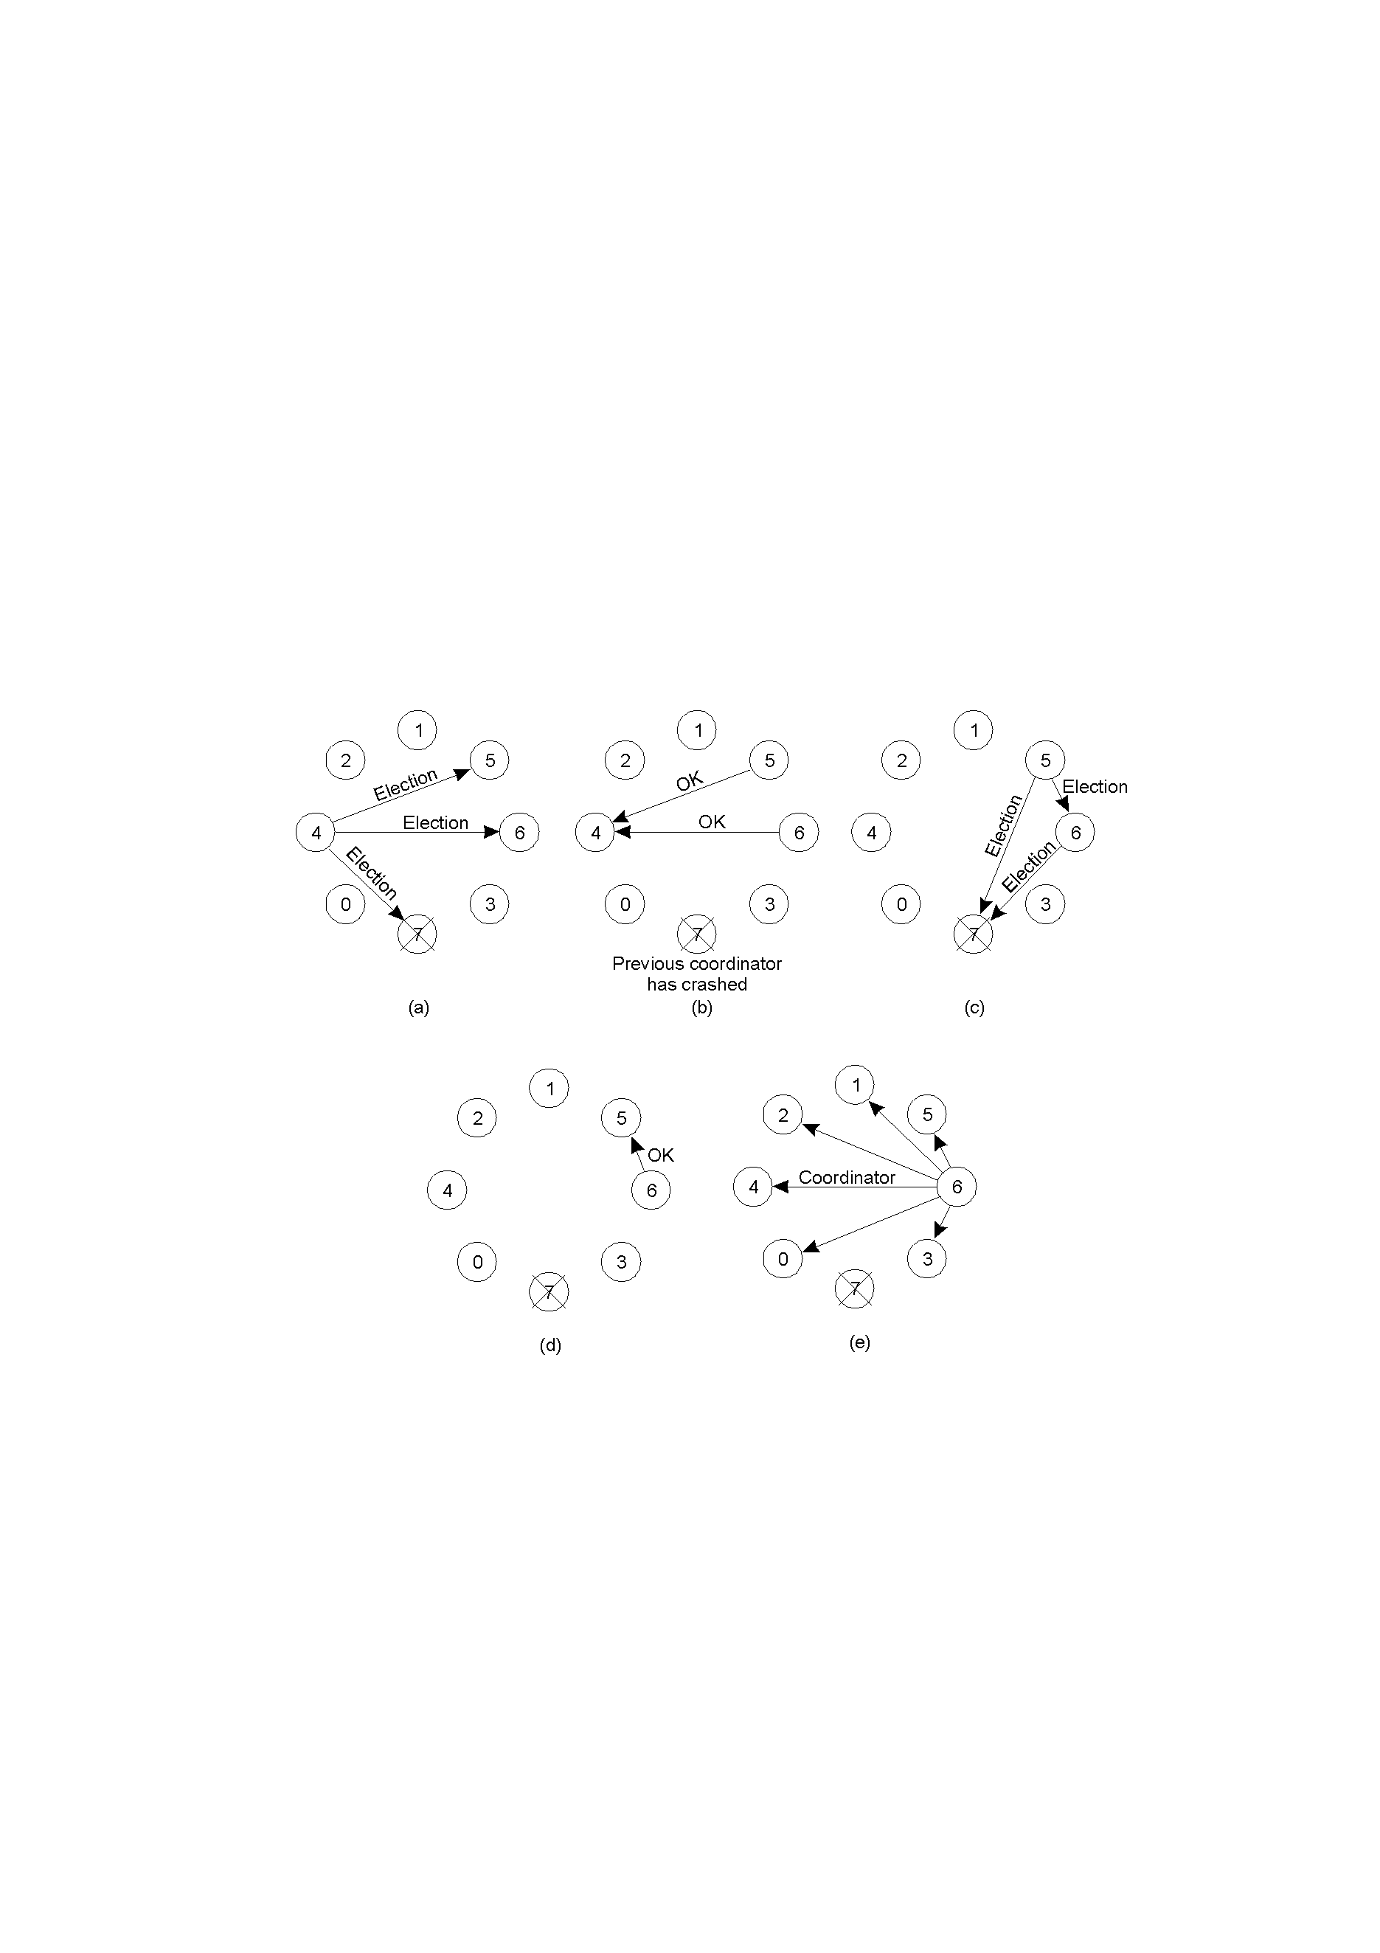
The Bully Algorithm (1)
The bully election algorithm
Process 4 holds an election
Process 5 and 6 respond, telling 4 to stop
Now 5 and 6 each hold an election
V1.2
Distributed Algorithms

Slide 19
Bully Algorithm (2)
Process 6 tells 5 to stop
Process 6 wins and tells everyone
V1.2
Distributed Algorithms

Slide 20
Ring Algorithm
Processes are logically ordered and each processor knows the ring topology.
The process calling the election (initiator) builds a message containing its process number and sends it to its successor.
Each process adds its own process number to the message before forwarding it.
The message, on returning to the initiator, is used to select the process with the highest ID.
The initator sends a new message around the ring to declare the result.
V1.2
Distributed Algorithms

Slide 21
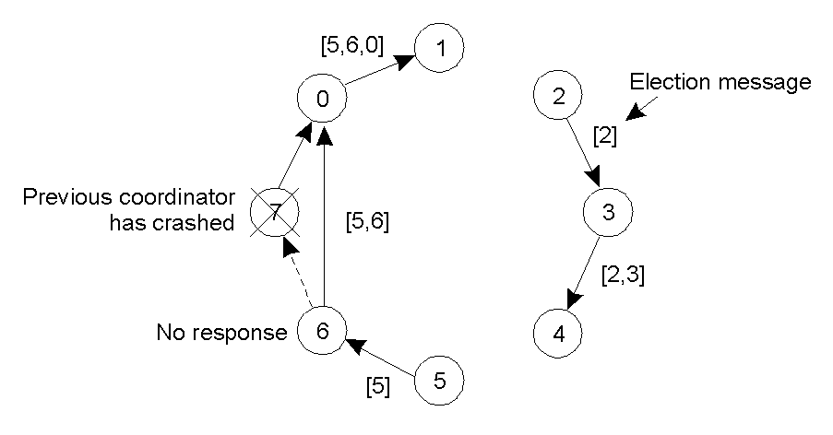
A Ring Algorithm
Election algorithm using a ring.
V1.2
Distributed Algorithms

Slide 22
Election Algorithm
How can the message load be reduced?
How does a process rejoining the system discover who the coordinator is?
V1.2
Distributed Algorithms

Slide 23
Deadlocks in Distributed Systems
Deadlocks may be handled by a number of different strategies:
  Ostrich strategy - hope they will go away
  Detection - let them happen, detect them and fix them
  Prevention - statically prevent deadlocks from happening
  Avoidance - avoid by allocating resources carefully
V1.2
Distributed Algorithms

Slide 24
Centralized Deadlock Detection
Each node maintains its own resource graph and a central coordinator maintains a resource graph for the whole system.
When the coordinator detects a deadlock it kills one process to break the deadlock.
V1.2
Distributed Algorithms

Slide 25
Centralized Deadlock Detection
A mechanism is needed for individual nodes to forward resource graphs to the coordinator:
  Inform the coordinator when an arc is added or deleted
  Periodically inform the coordinator of changes since the last update
  The coordinator asks for information when it needs it
Any of these mechanism can lead to a false or missed deadlocks.
A mechanism could be devised that uses timestamps but this would be very expensive.
V1.2
Distributed Algorithms

Slide 26
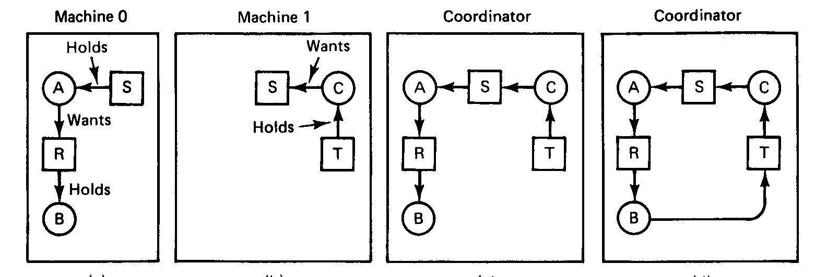
Centralized Deadlock Detection
V1.2
Distributed Algorithms

Slide 27
Distributed Deadlock Detection
Many distributed deadlock detection algorithms have been proposed.
In this example processes are allowed to request multiple resources at once.
The Chandy-Misra-Hass algorithm is invoked when a process has to wait for a resource.
V1.2
Distributed Algorithms

Slide 28
Distributed Deadlock Detection
A probe message is generated containing the id of the blocked process, the id of the process sending the message and the id of the process to whom the message is being sent.
The probe message is sent to all processes holding needed resources.
When a process receives a probe message it either absorbs the probe if it is not waiting on a resource or sends on the probe message updating the source and destination fields.
V1.2
Distributed Algorithms

Slide 29
Distributed Deadlock Detection
If a process receives a probe with its own id as the blocking id then a cycle exists.
Once a cycle has been detected the process that originated the probe may commit suicide, which causes problem if several probes are sent at once. Or ask the process with the highest process id in the cycle to commit suicide.
V1.2
Distributed Algorithms

Slide 30
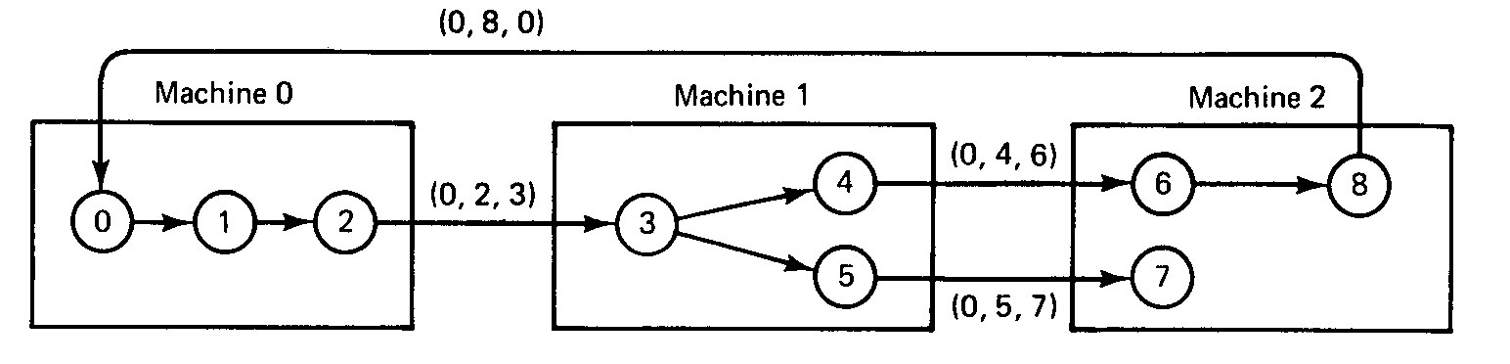
Distributed Deadlock Detection
V1.2
Distributed Algorithms

Slide 31
Distributed Deadlock Prevention
Deadlock prevention consists of carefully designing a system so that deadlocks are structurally impossible.
  requiring processes to hold only one resource at a time.
  requiring processes to request all of their resources initially.
  requiring processes to release all held resources when asking for a new one.
V1.2
Distributed Algorithms

Slide 32
Distributed Deadlock Prevention
Timestamps may be used by only allowing a process to wait for a resource if the process currently holding the resource is younger than itself. Typically, this would be used in a transaction based environment with the timestamp associated with the start of a transaction. wait-die algorithm.
V1.2
Distributed Algorithms

Slide 33
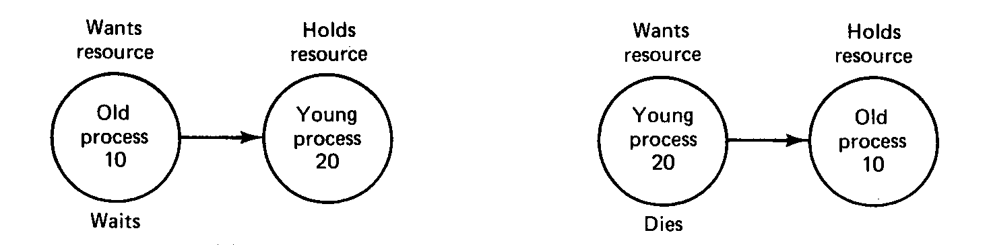
Distributed Deadlock Prevention
Wait-Die
V1.2
Distributed Algorithms

Slide 34
Distributed Deadlock Prevention
Alternatively in a transaction based environment, the wound-wait algorithm allows an older transaction to forcibly wound (ie pre-empt) a younger transaction that holds a resource it needs. Presumably the conquered transaction is restarted. When a younger transaction needs a resource that an older transaction has it waits.
V1.2
Distributed Algorithms

Slide 35
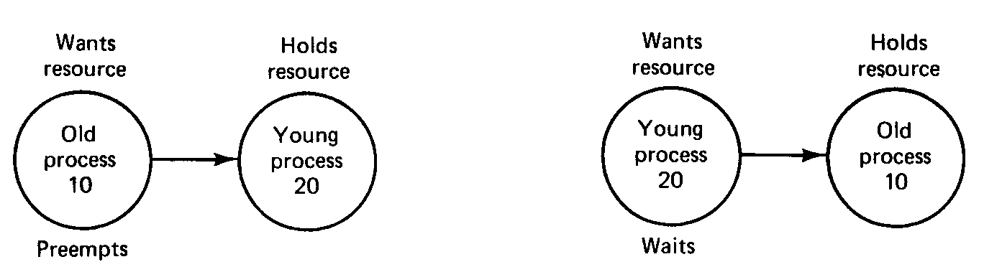
Distributed Deadlock Prevention
Wound-Wait
V1.2
Distributed Algorithms

